Slide 1
Constitutional and Political development 1947-1956
Initial problems of Pakistan
Structure of government of Pakistan
1st constituent assembly
Constitution making issues
2nd constituent assembly

Slide 2
Initial problems of Pakistan
Congress reaction to the establishment of Pakistan
Mountbatten wanted to become Governor-General of both India and Pakistan
Jinnah had not accepted it. Mountbatten became Governor-General of India. The Congress leaders with the cooperation of Mountbatten started to create problems for Pakistan
Formation of Government Ministry
Most of the civil servants were either British or Hindus and they migrated to India. At the time of partition there were total 980 ICS (Indian civil service) officers. Out of which almost 468 were Europeans, 352 Hindus, 101 Muslims and other included Christians, Scheduled Caste, Parsi, etc.

Slide 3
Pakistan was compelled to appoint the British officers to overcome the shortage e.g Sir Frank Messervy was first army chief of Pakistan up to 1948, Douglas Gracy was the second army chief up to 1951.
Division of Armed Forces and Military Assets
British commander in chief of military Auchinleck was in favor of keeping one military for both the nations
On the insistence of Muslim League he had accepted the division of the military assets
It was decided that the military assets would be divided on the ratio of 36% and 64% for Pakistan and India
there were 16 ordinance factories in British India which were in those regions where India was created
Hence Pakistan was given Rs 60 million in lieu of those factories. An ordinance factory was thus established at Wah in Pakistan.

Slide 4
The Massacre of Muslim Refugees and their influx in Pakistan
The Hindus and Sikhs initiated the massacre of the Muslims refugees in Punjab who were migrating to Pakistan
In eastern Punjab the army of the princely states of Patiala, Kapurthala, Alwar, Bharatpur also joined Hindus and Sikhs in the massacre of the Muslims
The Muslim women, children, and poor men were slaughtered.
The Muslim women were raped and killed by the Sikhs and the Hindus.
The trains were stopped at certain places by Hindus and Sikhs in which the Muslims were killed or burned.

Slide 5
Division of Financial Assets
The total budget of the British India at the time of partition was Rs 4 Billion.
The share of Pakistan was Rs 750 million.
India initially paid Rs 200 million to Pakistan and Sardar Patel stopped the remaining amount.
Gandhi demanded that the share of Pakistan should be given, he went on hunger strike.
As a result of which the Rs 500 million was paid to Pakistan, but Rs 50 million was not given.
Canal Water Dispute
On 1st April, 1948 India stopped the water of Ravi and Sutlej at Madhopur and Ferozpur headworks respectively.

Slide 6
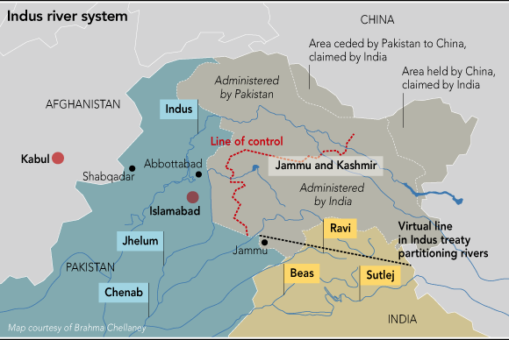

Slide 7
Pakistan’s economy was predominantly agricultural, and the water was the backbone of Pakistan’s economy.
Pakistan was compelled to purchase the water from India in the initial times.
Pakistan took the issue to World Bank; as a result of which, Indus water treaty was signed between India and Pakistan in 1960.
The control of three eastern rivers: Sultej, Ravi, and Beas was given to India, and the control of three western rivers: Indus, Jehlum, and Chenab was given to Pakistan.
The Accession of Princely States
Junagarh
The ruler of the princely state was a Muslim but most of the population were Hindus..

Slide 8
After the partition of India Junagarh and a small contagious princely state of Manavadar gave its accession to Pakistan.
Mountbatten had not accepted the accession of these states to Pakistan and declared it as a violation of the sovereignty of India.
He surrounded the princely state of Junagarh with Indian troops and put an economic blockade by cutting of its rail links with India.
The Indian army conducted a referendum in Junagarh.
As most of the population were Hindus, they voted in favor of accession to India
Hyderabad
The ruler of Hyderabad was a Muslim who was known as Nizam. The State of Hyderabad was a rich state economically. The annual revenue of the state was Rs 260 million, and the state had its own system of currency and postage stamps.

Slide 9
Therefore the state asked for an independent status like that of Pakistan and India from British.
Mountbatten made it clear that it was not possible for the British government to grant a dominion status to Hyderabad.
He said that the state was surrounded by the Indian Territory on all the four sides, hence it was not possible to give it an independent status.
The Nizam instead of acceding of India demanded that the state would enter in a deal with India for combined defense, foreign affairs, and communication.
The state launched complaint against the India in United Nations Security Council.
However, before the UN could not take any decision regarding the status of the state. The Indian army entered the state and brought it forcefully under the control of Inda.

Slide 10
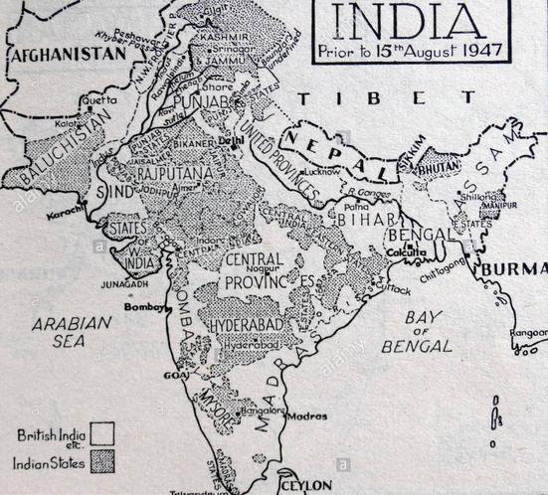

Slide 11
Kashmir
The state of Kashmir was created when the British sold it to the Dogra ruler Gulab Singh by treaty of Amritsar in 1846.
The princely state had most of the Muslim population, but the ruler were the Sikhs. At the time of partition of sub-continent the state was ruled by the Sikh Maharaja Hari Singh.
The population wanted to accede to Pakistan. The public pressurized the Maharaja to accede to Pakistan. The Maharaja started to oppress the local Muslim population as a result of which they revolted against the Maharaja.
The Tribesmen from the North-West Frontier Province also joined the rebellion.

Slide 12
The Maharaja asked India for military assistance. India demanded to give a letter of accession to India of the state of Jammu and Kashmir. Maharaja gave the letter of accession to India; consequently, India sent its forces to Kashmir.
When the Indian army entered the region of Kashmir, Pakistan also sent its forces in Kashmir due to which the first Kashmir war was started. India blamed Pakistan for aggression and took the issue to United Nations.
Thus United Nation Commission for India and Pakistan was created to resolve the dispute.
It was decided in the resolutions of UNCIP that a cease fire line would be created, and a referendum would be held in Kashmir to ask the opinion of local population.
However no referendum was held under the UNCIP till now in Kashmir.

Slide 13
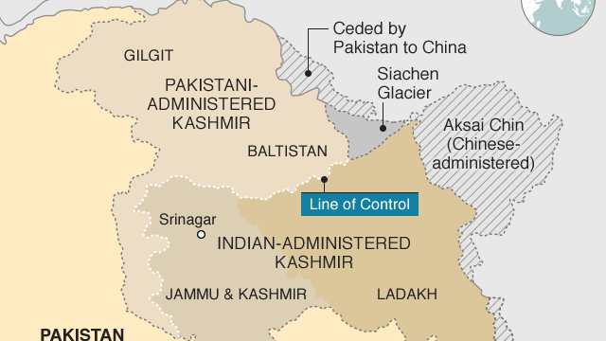

Slide 14
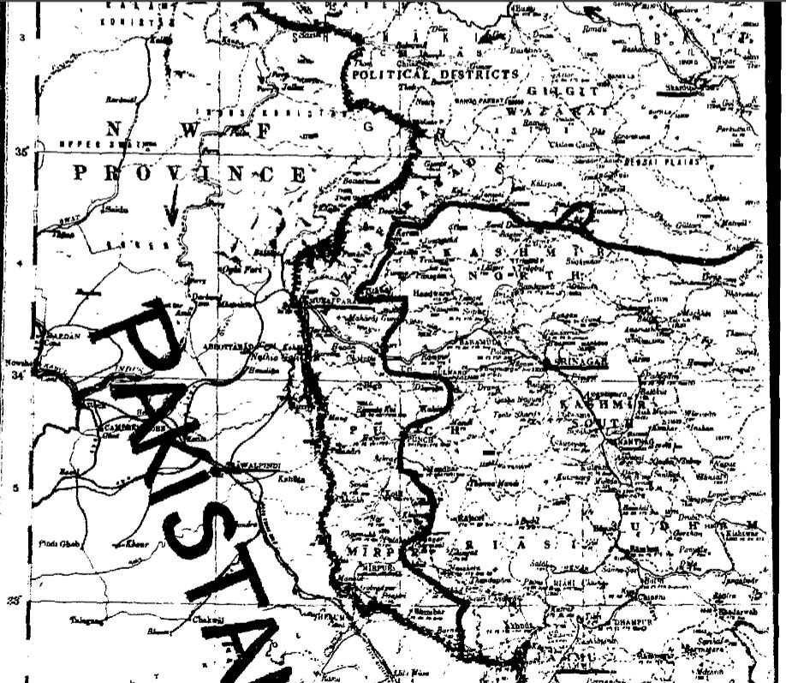

Slide 15
Economic Problems
When Pakistan was created it comprised of those regions which were economically underdeveloped.
Most of the industries were located in India e.g Calcultta was given to India during the partition of Bengal.
The agriculture was also not developed to meet the needs of the country.
The two wings of Pakistan, that is East and West Pakistan, was separated from each other with the Indian territory. The Hindus were dominating the trade and the commerce of India.
The railway system and the river transportation in East Pakistan was in depleted condition.

Slide 16
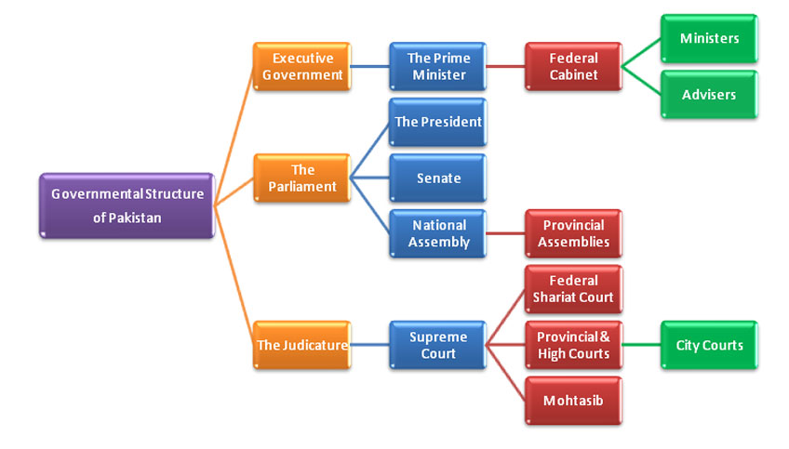

Slide 17
Executive
The executive authority rest with Prime Minister, who is the head of government. He exercise the executive authority through his cabinet. The cabinet involves the federal ministers and advisors. Each minister head a federal ministry. The government policy is implemented through each ministry.
Parliament
Presently, the parliament of Pakistan is bi-cameral. By bi-cameral means that there are two houses one is upper house (senate) the other is lower house (national assembly). Senate is the representation of territory every province have equal seats in senate. National Assembly is the representation of the population, the seats are proportional to the population of each province. President is the head of state, but the real powers rest with Prime minister. There are four provincial assemblies in Pakistan which are uni-cameral that is they have just one house. The function of parliament is to make laws.

Slide 18
Judiciary
Judiciary perform the function of interpreting the constitution as well as the laws that are formulated by the parliament. The lowest order courts are district courts; then at provincial level there are high courts. Supreme court is the highest court in Pakistan. The high courts are managed by the supreme court. The chief justice of Pakistan is appointed by President and the other judges of Supreme court and high courts are appointed by the chief justice of Pakistan in consultation with the President. There is also a federal sharia court which advises the government in matters related to Sharia.

Slide 19
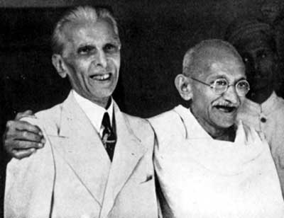
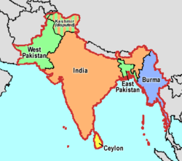
Pakistan was created under Independence Act of 1947, the Act made existing Constituent Assemblies, the dominion legislatures
1947-Independence Act was based on 1935 Indian Act

Slide 20
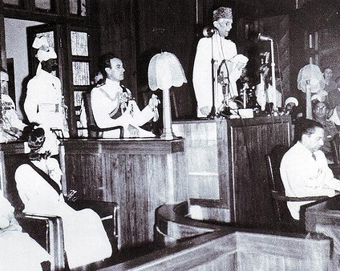
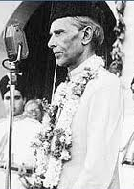
The first session of the first Constituent Assembly was held on 10th August 1947 at Sindh Assembly building Karachi
On 11th August Mr. M A Jinnah was elected unanimously as the president of Constituent Assembly of Pakistan and national flag was formally approved by the Assembly. Mr. Jinnah made his historical speech.

Slide 21
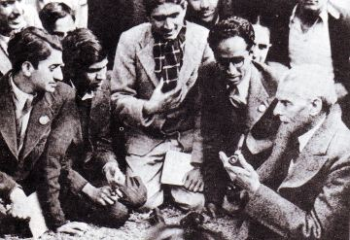
On 12th August a resolution was passed which declared Mr. Jinnah as “ Quaid-e-Azam Mohammad Ali Jinnah”
On the same day a special committee was called the
“ Committee on Fundamental Rights of citizens and minorities of Pakistan” was appointed.

Slide 22
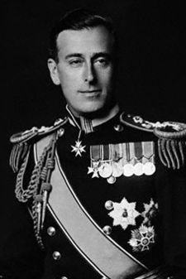
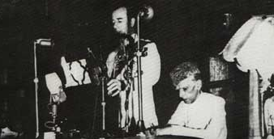
On 14th August 1947, the transfer of power took place and the Governor General of India, Lord Mount Batten addressed the Constituent Assembly of Pakistan.
On 15th August Quaid-e-Azam was sworn in as the first Governor General of Pakistan but he did not amend the interim Constitution which he could have amended as GG. He remained GG till his death i.e. 11th September 1948

Slide 23
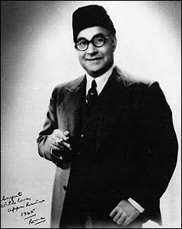
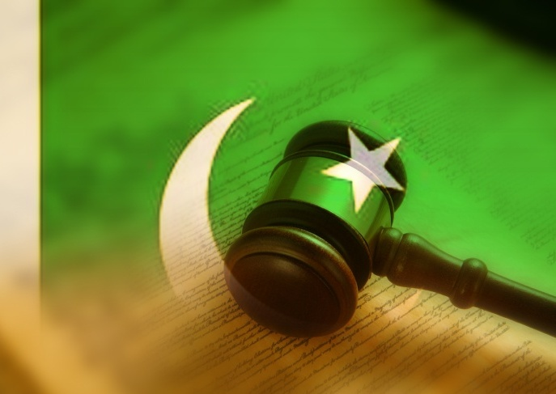
First Constituent Assembly:
The foremost task before the Constituent Assembly was to frame the Constitution
On 7th March 1949, the Objective Resolution, which now serves as the grund norm of Pakistan, was introduced by the first PM of Pakistan, Mr. Liaquat Ali Khan and was later adopted by the Constituent Assembly on 12th March 1949.

Slide 24
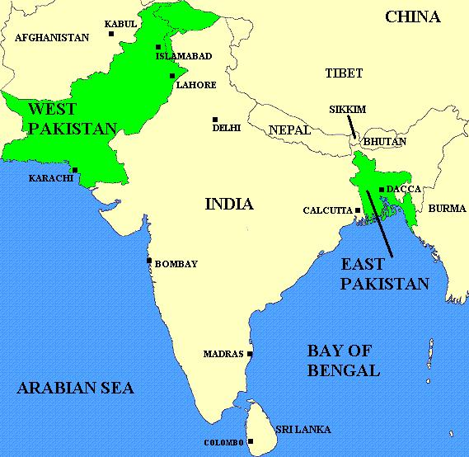
44% population
Geographical distance (separated by 1600 km of Indian Territory
56% population
4 provinces
1 province

Slide 25
Constitutional History of Pakistan
Constitution making issues (1947-1956)
1. Secular vs Islamic State
Objective Resolution 1949: Sovereignty belong to Allah Almighty
Rights of minorities were recognized to follow their religion and
culture (Ministry for minority affairs)
Fundamental rights of the people were secured (everyone could appeal to Supreme Court
No law shall be enacted against Koran and Sunnah

Slide 26
Federalism (center and province distribution of Power)
Distribution of power between provincial and federal government was decided as per the Government of India Act 1935
Federal list (subjects on which the federal government has the legislative power.
Provincial list ( subjects on which the provincial government has the legislative power)
Concurrent list (subjects on which both the provincial and federal government could legislate- however, incase of disagreement the federal legislation would receive priority.
Residual powers was vested in the head of the state (President or Governor General)

Slide 27
Representation
1st Basic Principal committee report 1950
Equal power for both houses
cabinet responsible to both houses
Lower house structure was not clear (East Pakistan resisted)
No mention of the composition and size of the assembly
2nd Basic Principal committee report 1952
Lower house was empowered (West Pakistan) resisted.
Cabinet responsible to lower house only
Equal representation in both houses of East Pakistan vis-à-vis West Pakistan 120 upper house: 400 Lower house.

Slide 28
Bogra Formula 1953
L.H U.P joint session
East Pakistan 165 10 175
West Pakistan 135 40 175
-------
350
Both houses given equal power

Slide 29
Language Issue
Urdu was declared as the official language of Pakistan
In 1953, Bangladeshi language movement emerged in East Pakistan
The Pakistani government tried to introduce Persian-Arabic script for the Bengali Language.
The Bangladeshi Language was recognized as the official language of Pakistan in 1956.

Slide 30
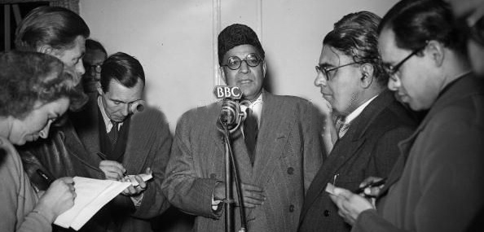
On the same day, a basic principles committee comprised of 24 members was formed to prepare a draft Constitution on the basis of Objectives Resolution

Slide 31
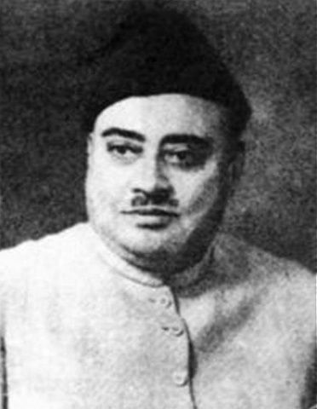
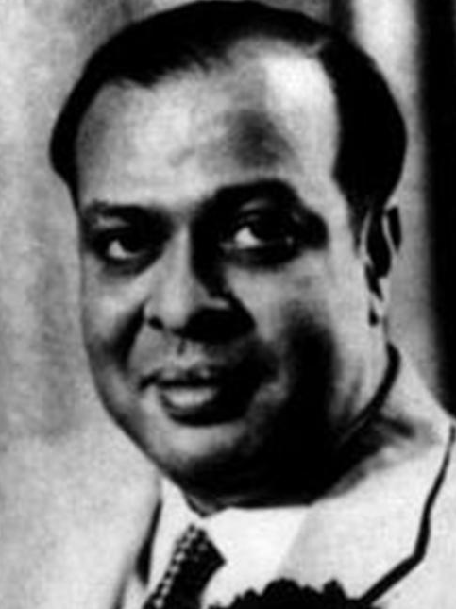
On 16th October 1951, PM Liaquat Ali Khan, mover of the Objective Resolution, was assassinated and Khuwaja Nazimudin took over as the PM on 17th October 1951
The final draft of the Constitution was prepared in 1954, by that time Mohd Ali Bogra had taken over as PM
Khuwaja Nazimudin
Mohd Ali Bogra

Slide 32
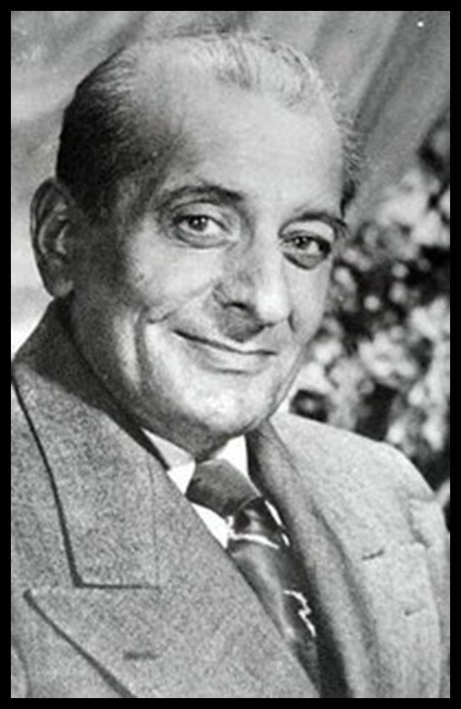
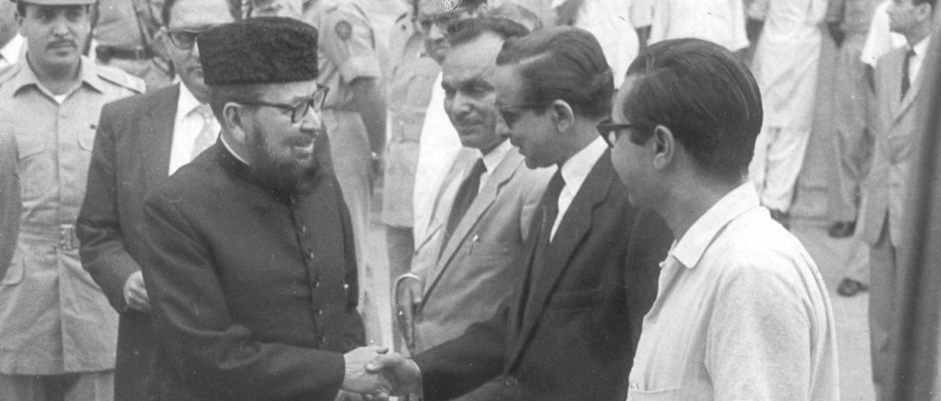
Just before the draft could have been placed in the House for approval , the Assembly was dissolved by the then GG Gulam Mohammad on 24th October 1954. The PM was however not dismissed until elections were held
Moulvi Tamizudin, President of Assembly, challenged the dissolution in the Sindh Chief Court and won the case
Malik Ghulam Muhammad
Moulvi Tamizudin

Slide 33
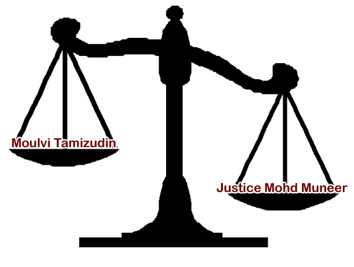
The Government in return, went to the Federal Court, where the famous judgment was given by the then CJ Mohd Muneer, according to which Maulvi Tameezudin lost the case

Slide 34
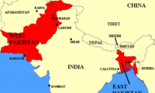
The 2nd Constituent Assembly
The second constituent assembly of Pakistan was created on 28th May 1955 under Governor General’s order no 12 of 1955
The electoral college of this Assembly was the provincial Assemblies of respective provinces and the strength of this assembly was 80 members ( half each from East and West Pakistan)
One unit was created by this assembly on the basis of parity

Slide 35
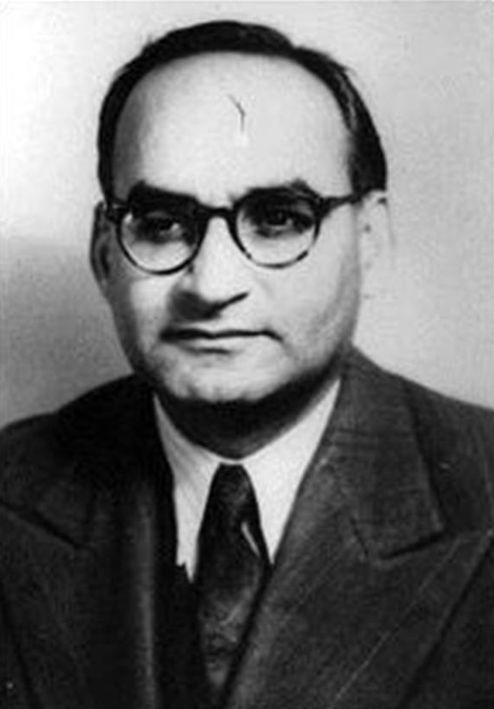
1956 Constitution
Pakistan’s first 1956 Constitution was also given by this Assembly and Chaudhri Mohd Ali was PM at that time
1956 Constitution was enforced with effect from 23rd March 1956
Under this Constitution Pakistan became an Islamic Republic
Chaudhri Mohd Ali

Slide 36
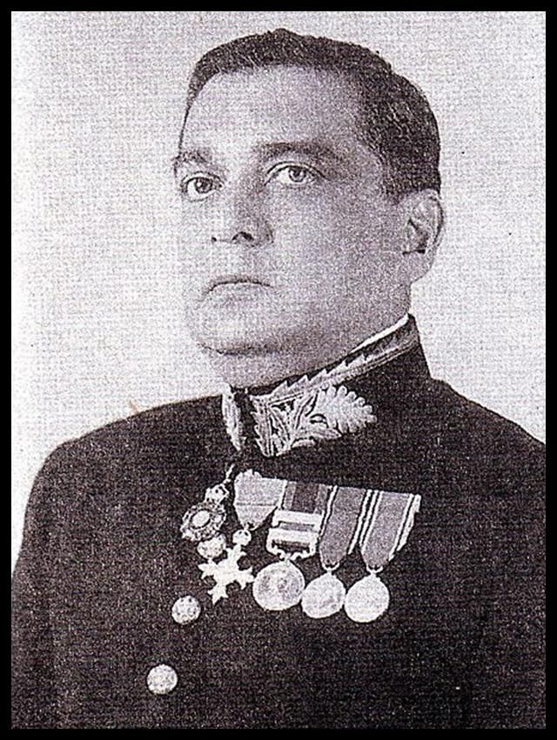
On 5th March 1956 Major General Sikandar Mirza became the first elected President of Pakistan
1956 Constitution provided parliamentary form of Government with all the executive powers in the hand of PM
Sikandar Mirza

Slide 37
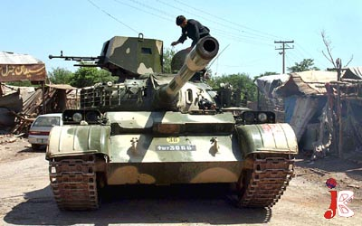
Under 1956 Constitution Parliament was unicameral
When the first general elections were scheduled for early 1959, president Sikandar Mirza abrogated the Constitution, dissolved National and Provincial Assemblies and declared Martial Law on 7th October 1958

Slide 38
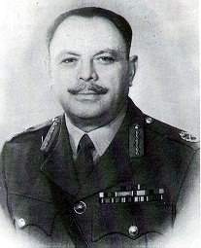
He Appointed General Mohd Ayub Khan Commander –in-Chief of Army as Chief Martial Law Administrator
On 27th October 1958 General Mohd Ayub Khan took over as president of Pakistan and he appointed Constitution commission on 17th Feb 1960 which was aimed to submit proposals for new Constitution based on the “ Islamic principles of justice”
General Mohd Ayub Khan

